Slide 1
Kneeling tasks with and without knee pads: repeatability and loading visualisation
Simon Thwaites, Mark Rickman, Kelly Hall, Dominic Thewlis
Simon Thwaites
Ph.D. Candidate
Centre for Orthopaedics & Trauma Research
The University of Adelaide
simon.thwaites@adelaide.edu.au

Slide 2
Motivation
Kneeling is integral to many occupational, cultural, religious, and leisurely activities.
Anatomical structures contacting the ground change with varying kneeling postures [1].
Identifying these structures would be beneficial in many clinical settings.
Aims
Develop a technique for visualising loading of the knee.
Calculate the repeatability of the technique.
[1] Palmer, J Bone Joint Surg Br, 2002

Slide 3
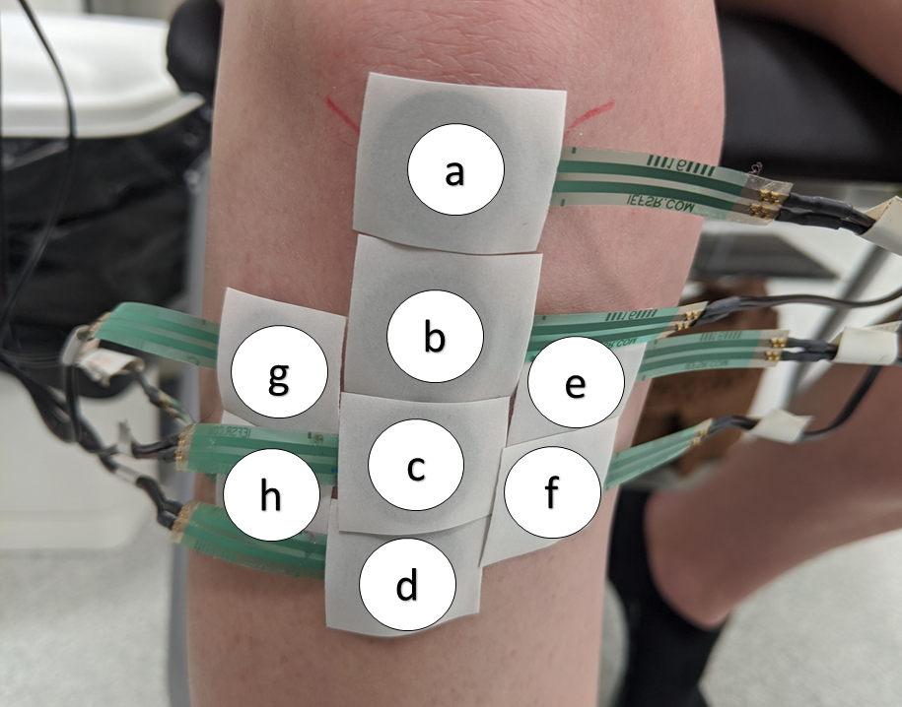
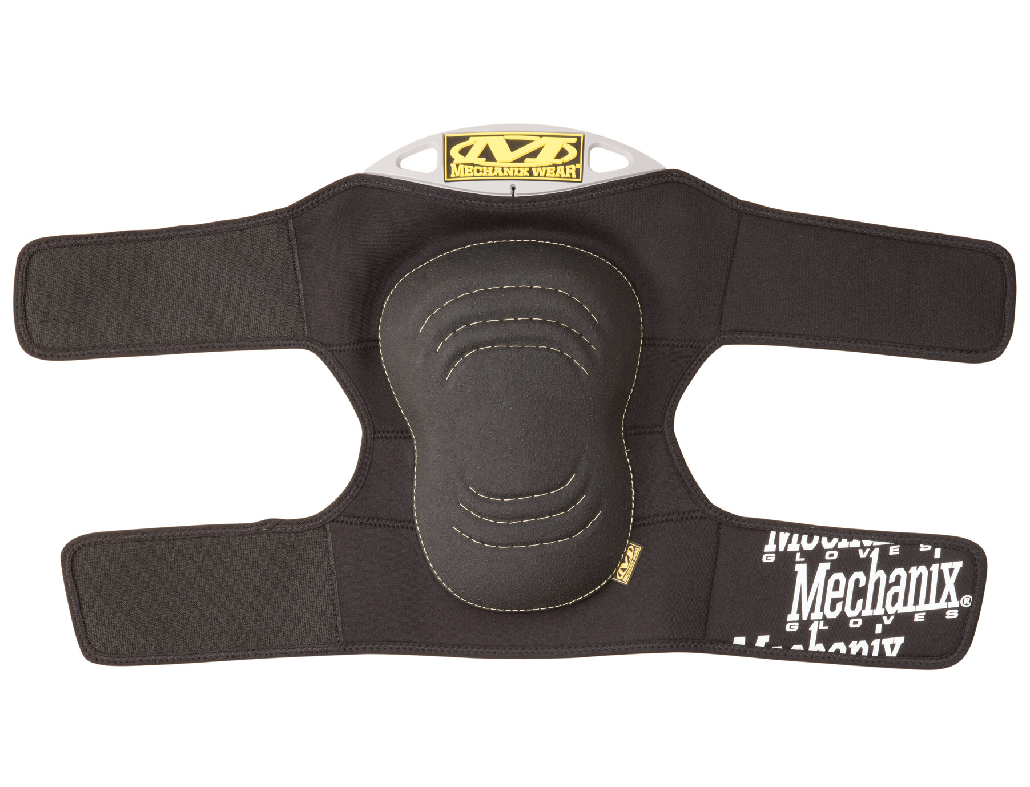
Method
14 healthy participants.
8 x force sensitive resistors (FSRs) (Delsys).
2 x testing sessions (min. 3 day break).
3 x trials: upright kneeling (60 sec), reaching forward, back, left, right (5 sec).
With and without kneepads (Mechanix).
Matlab & R for data analyses.

Slide 4
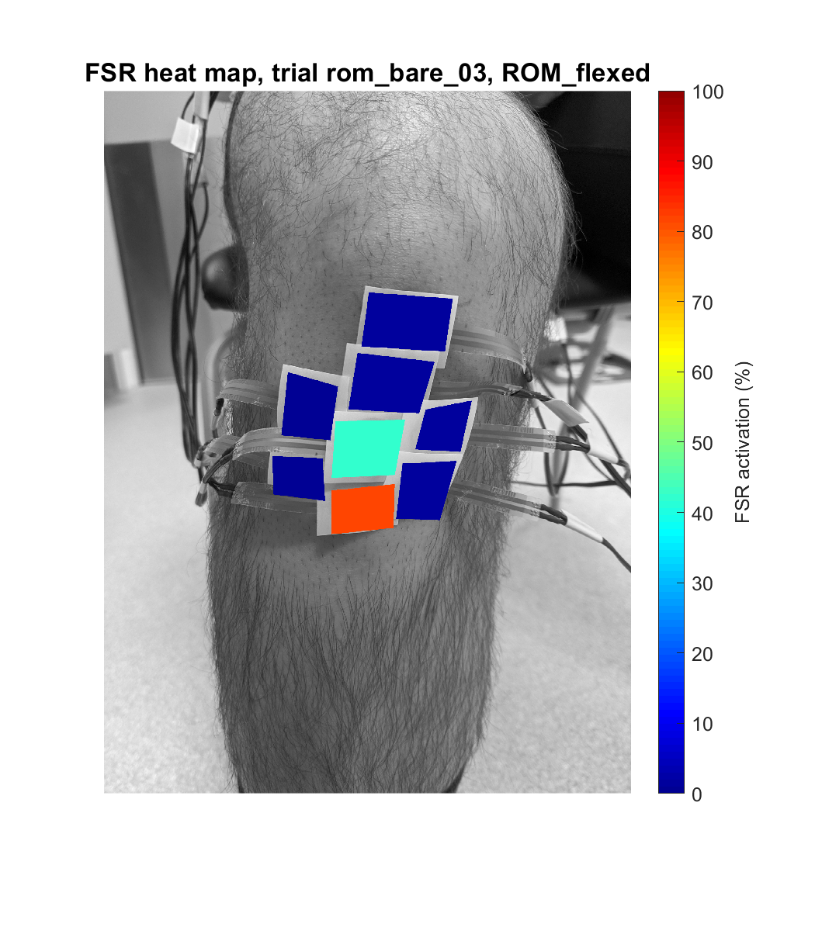
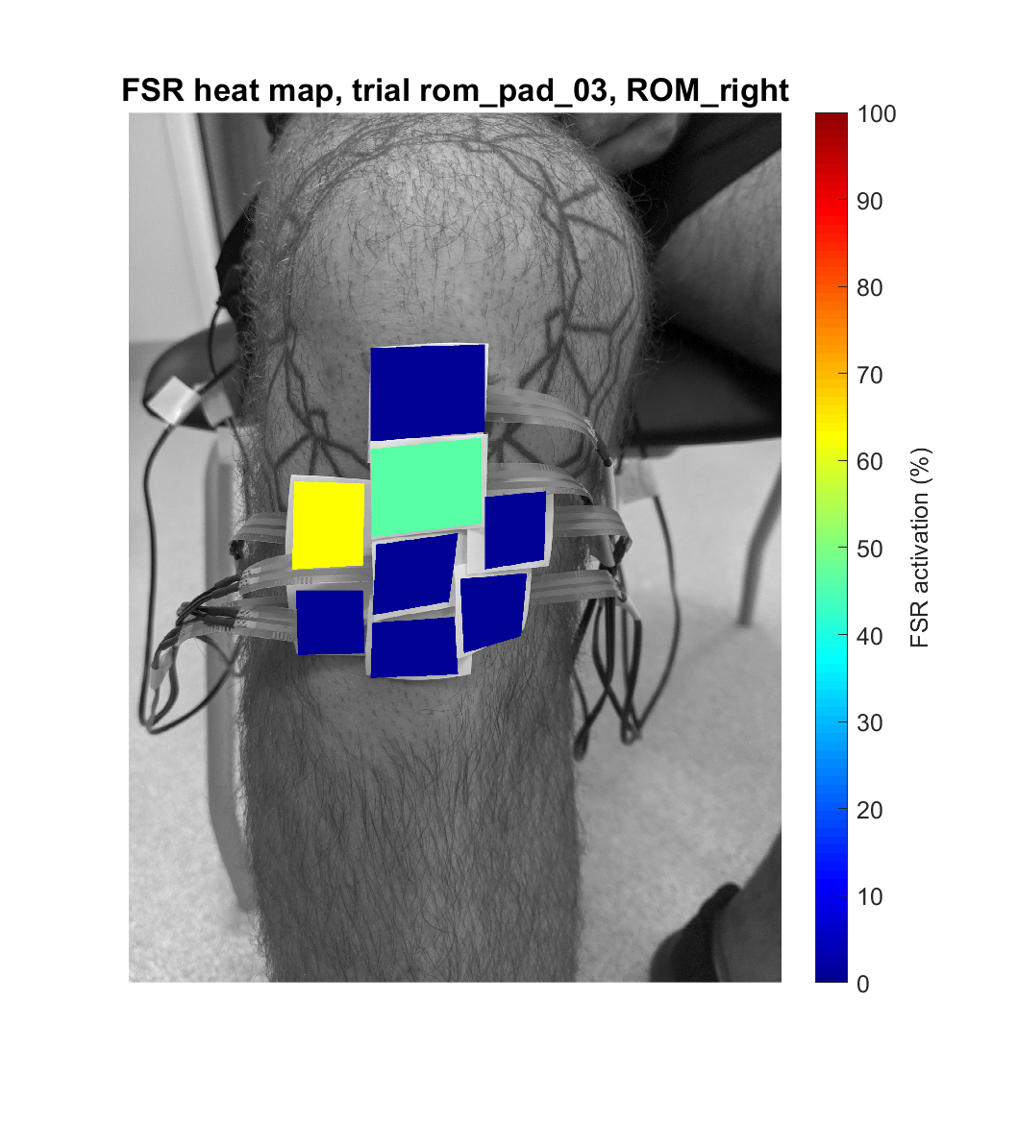
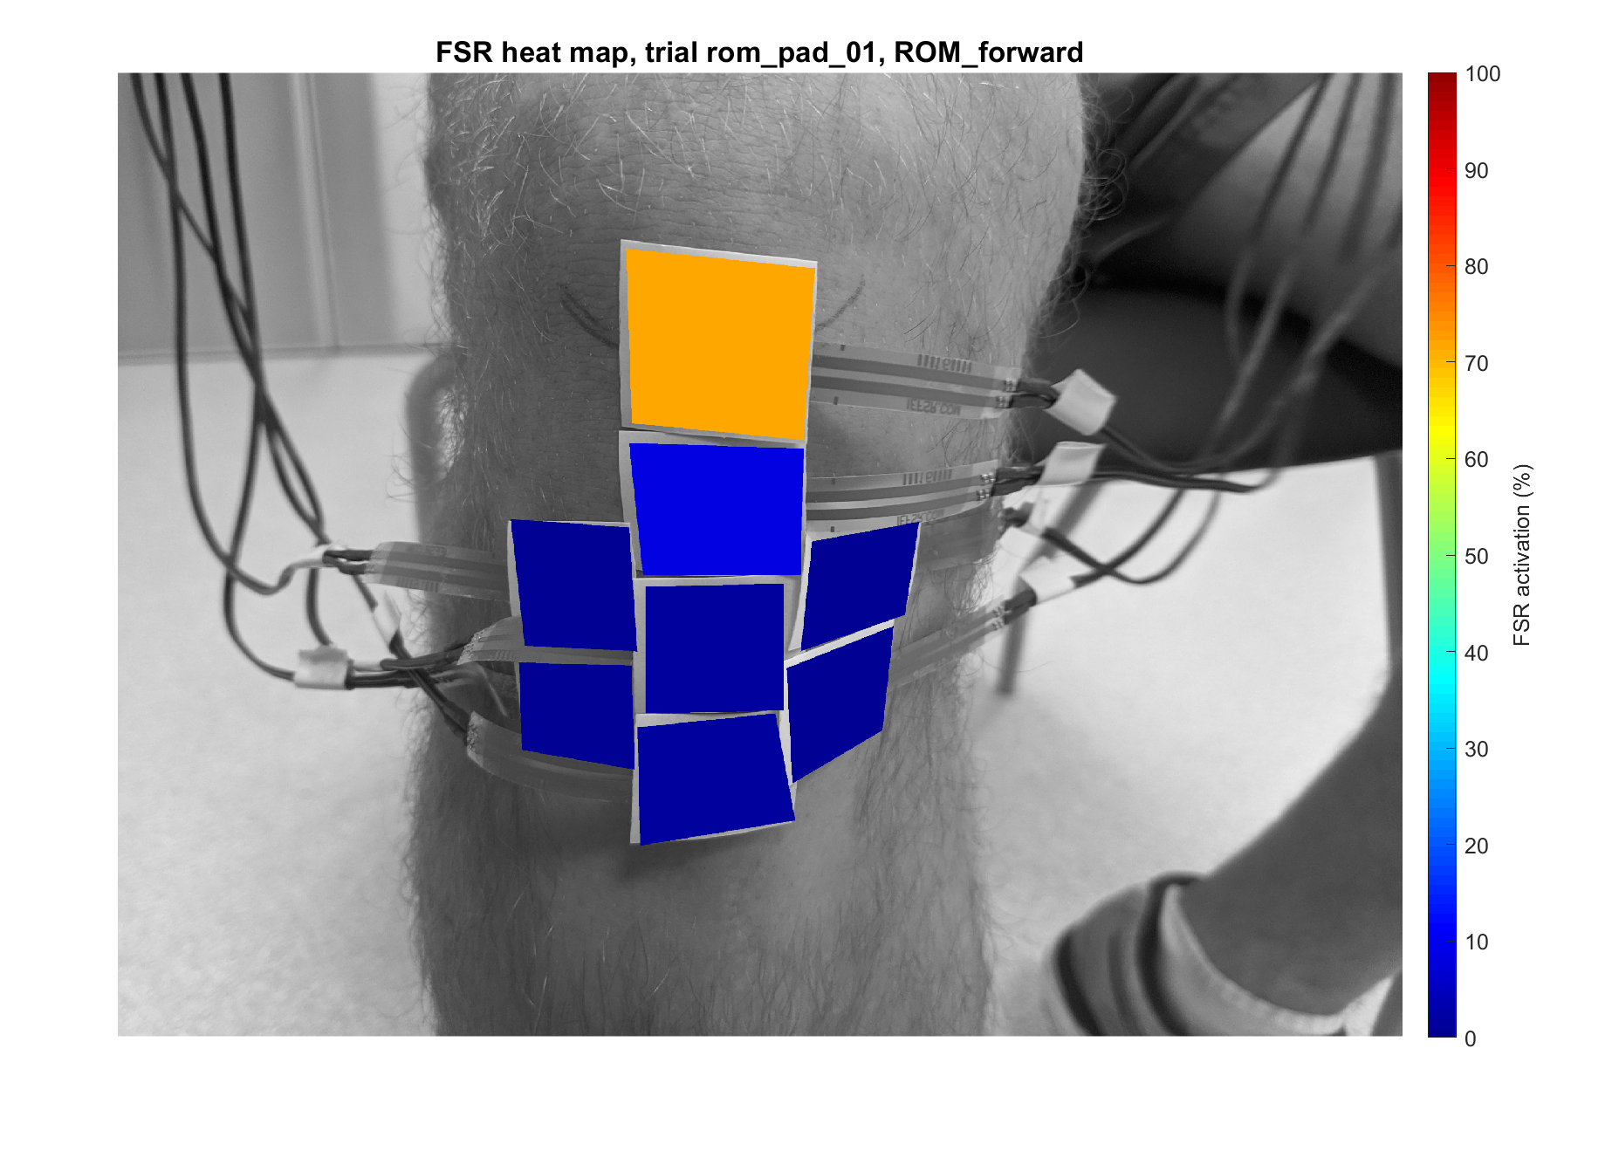
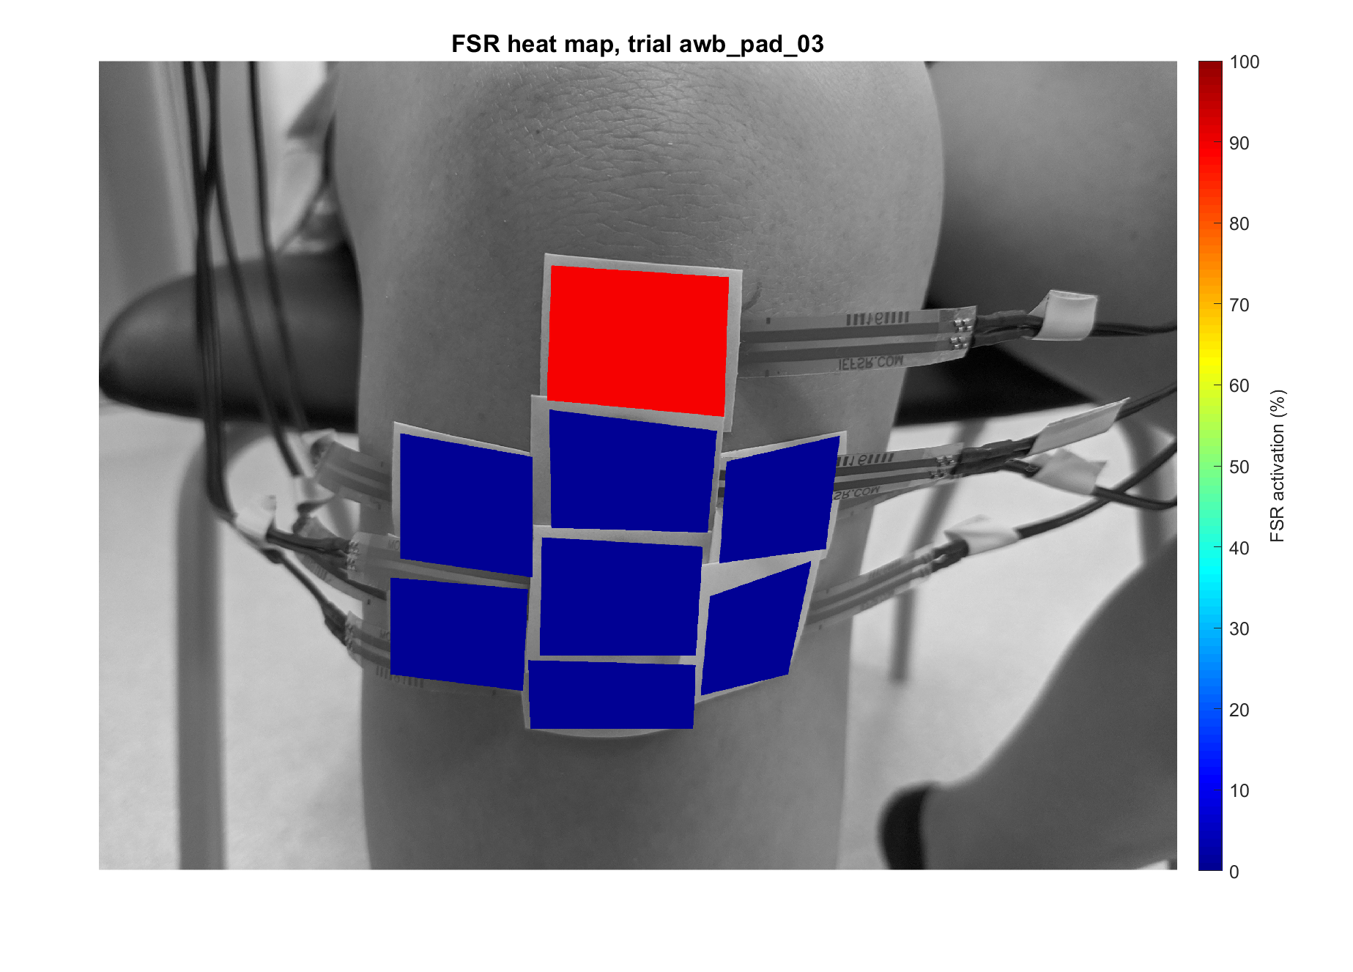
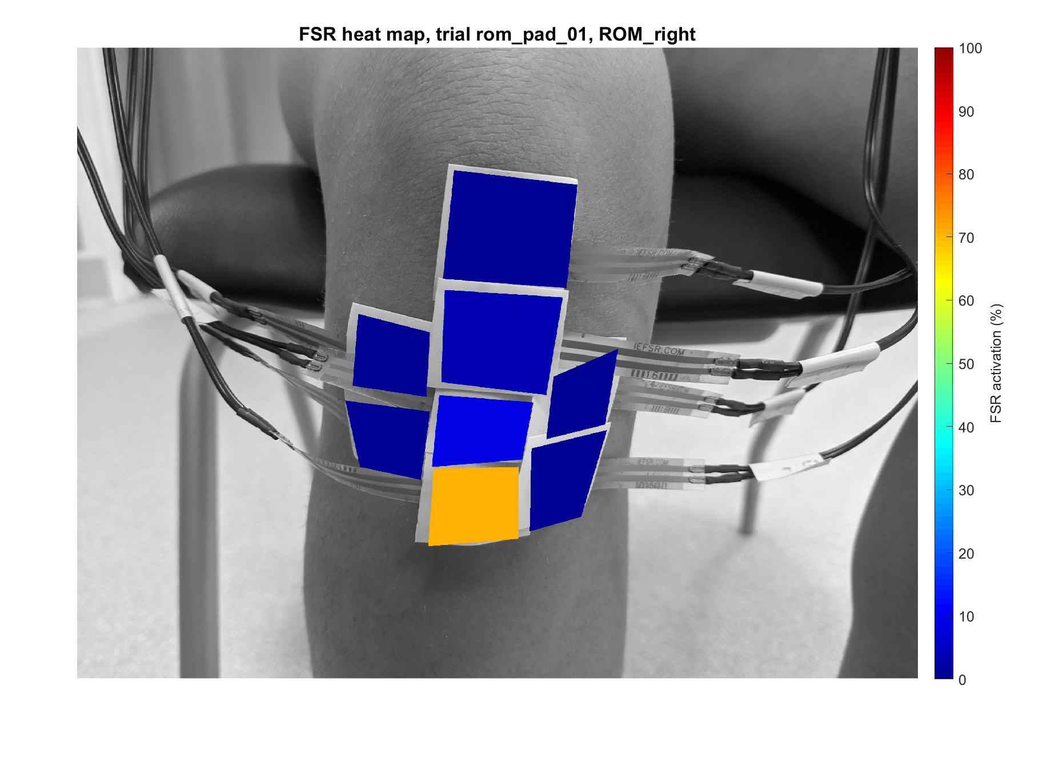
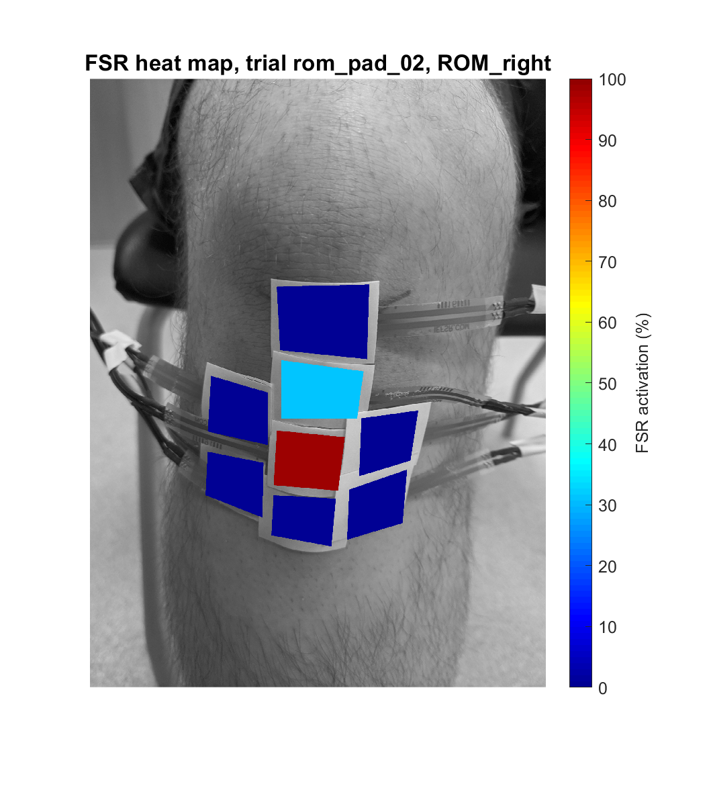
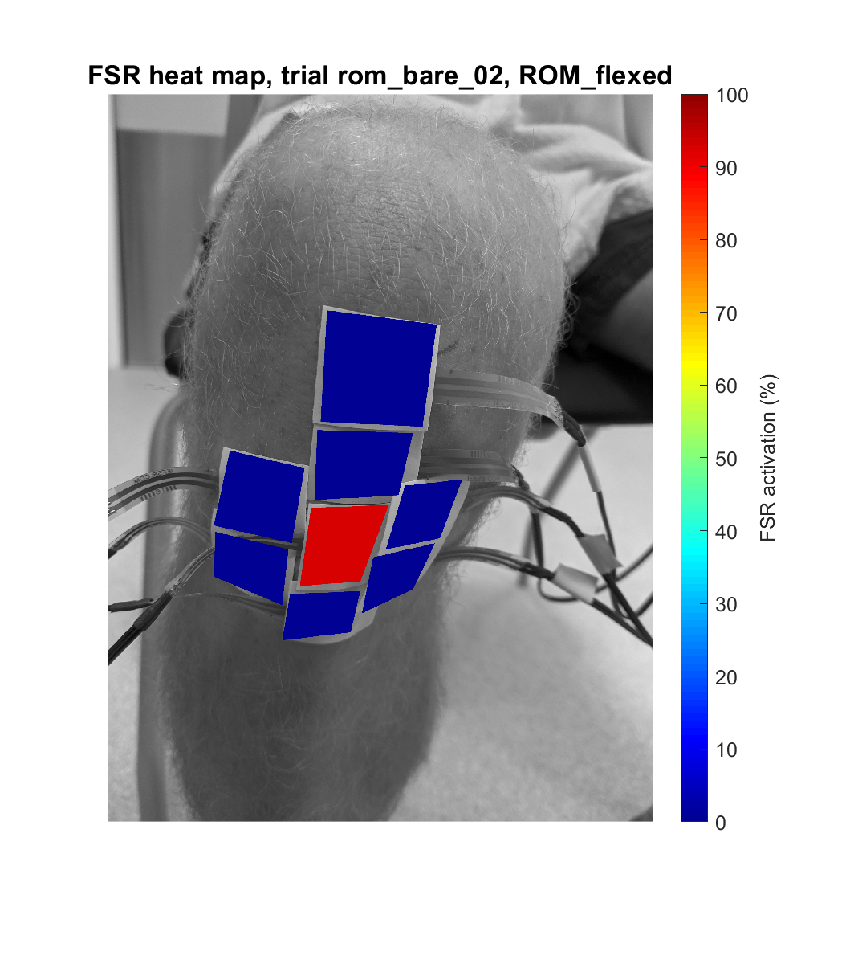
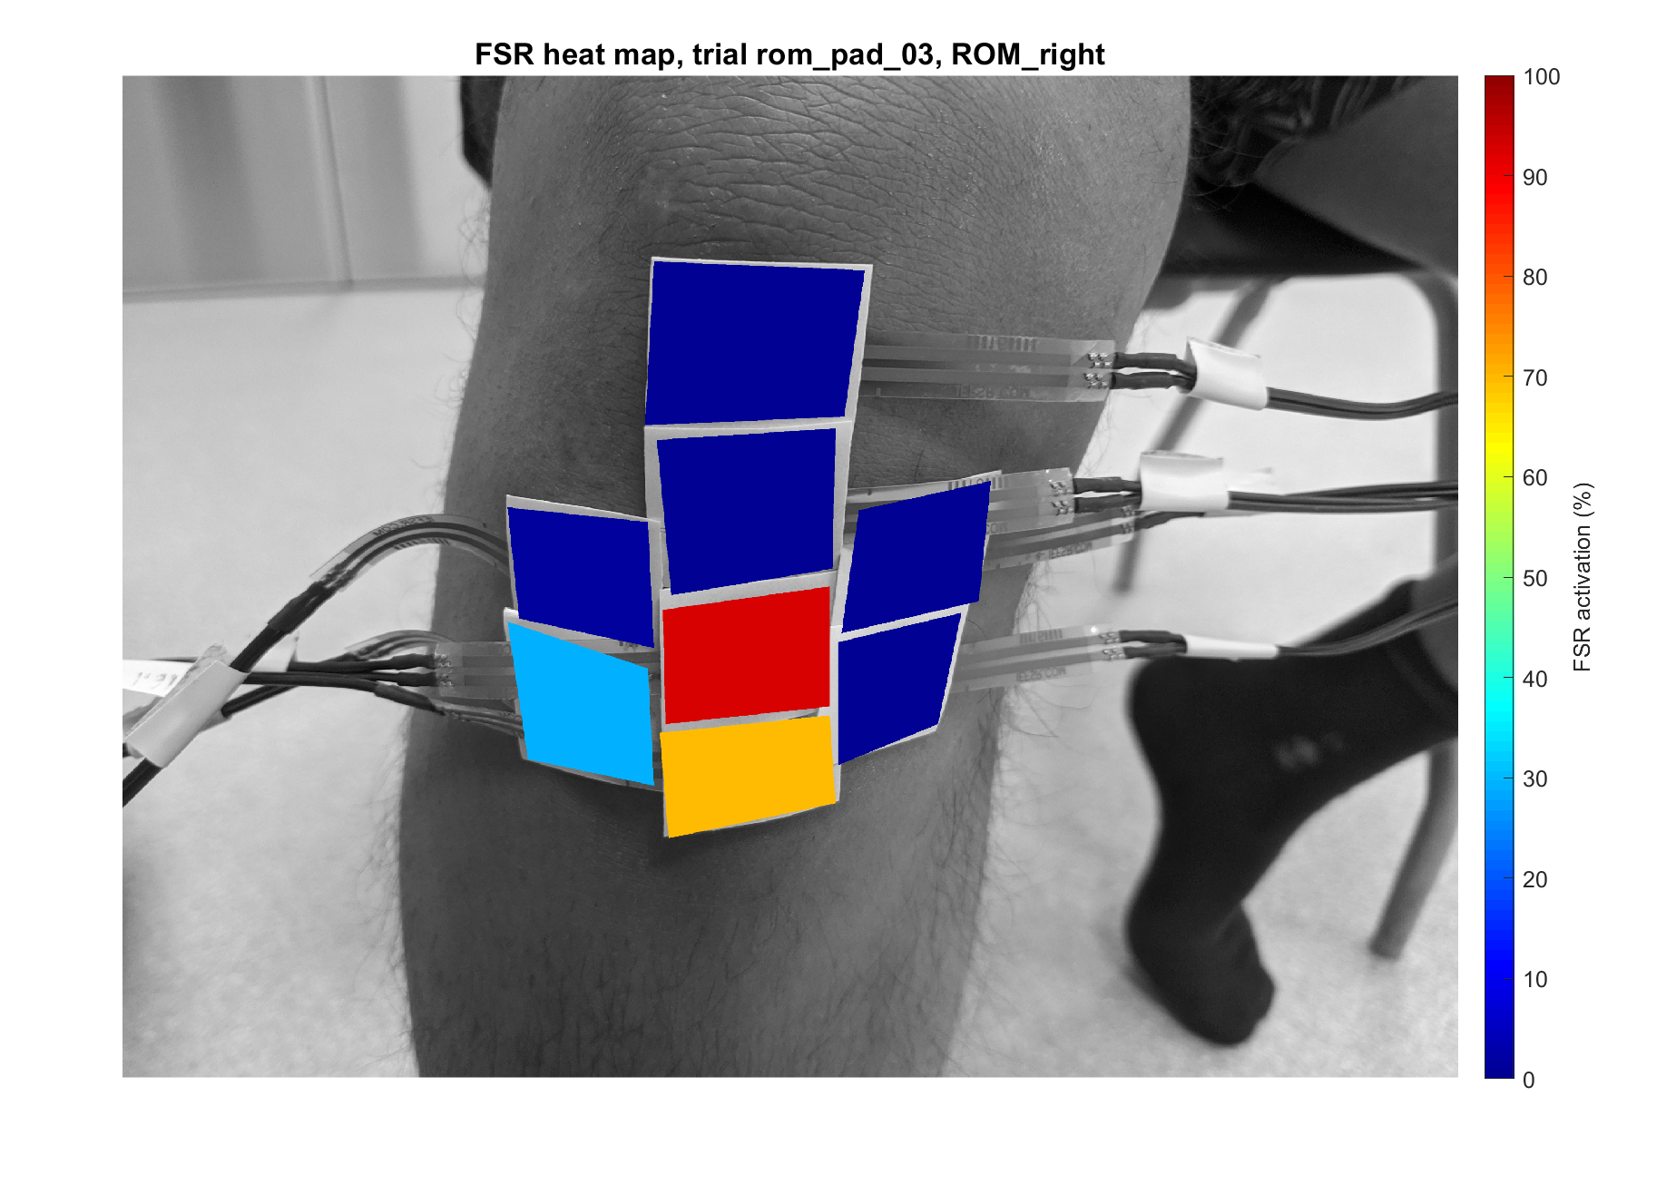
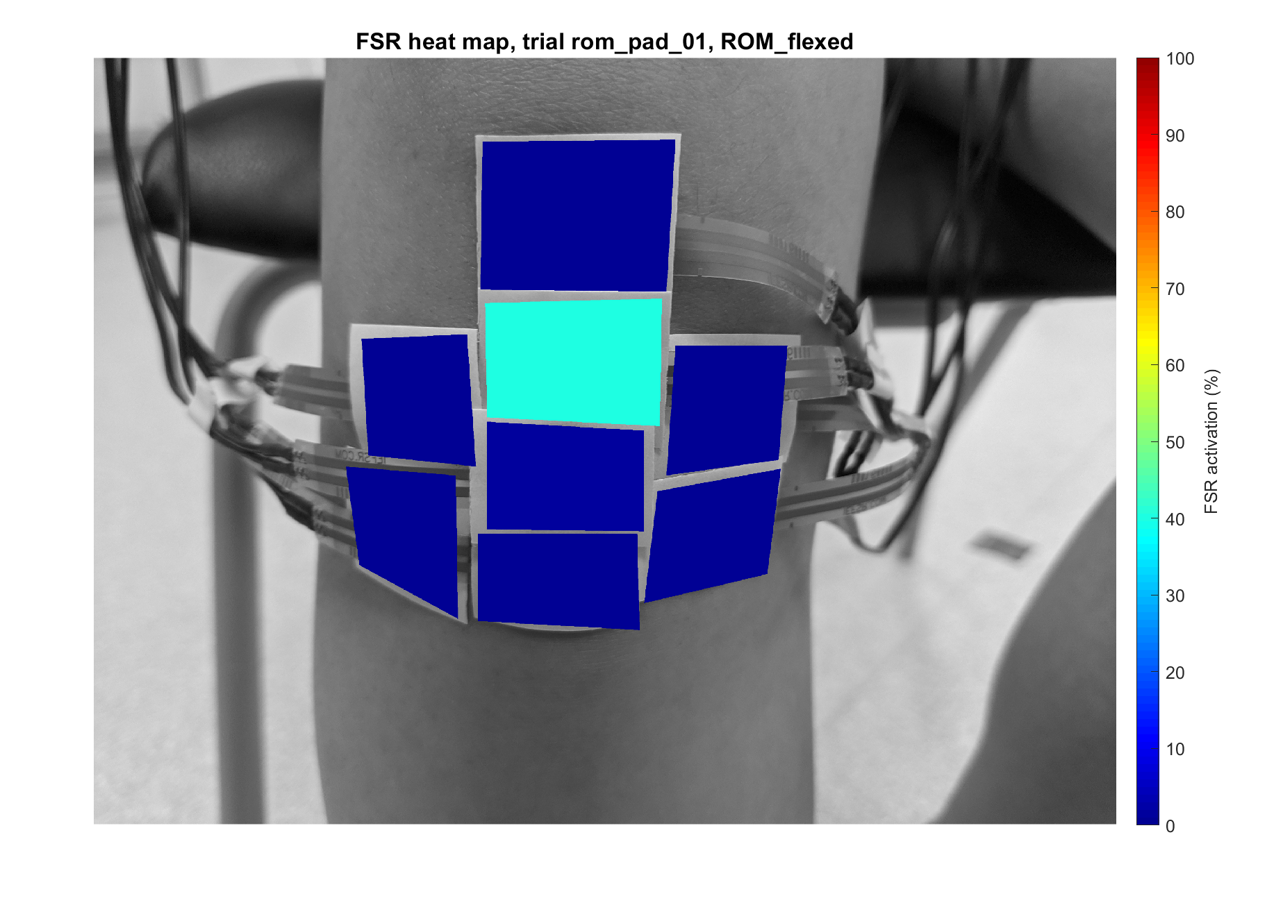
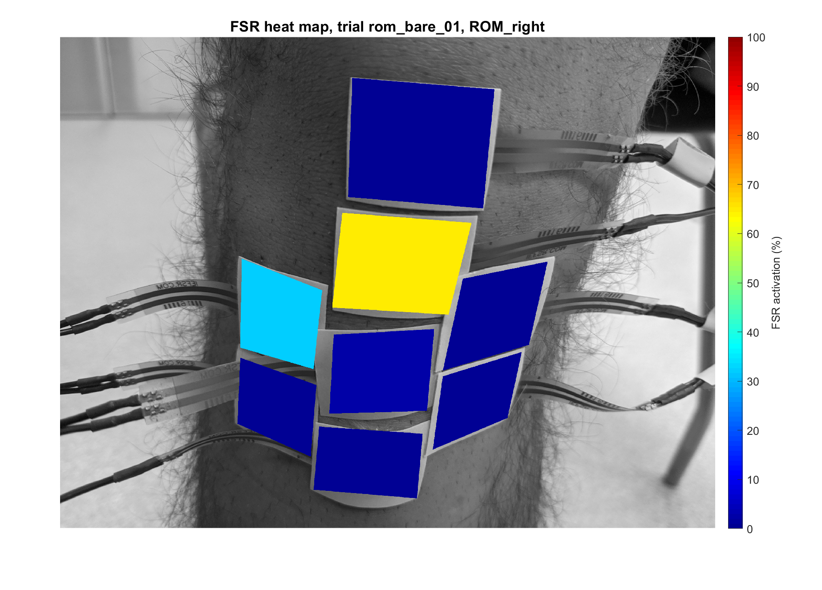
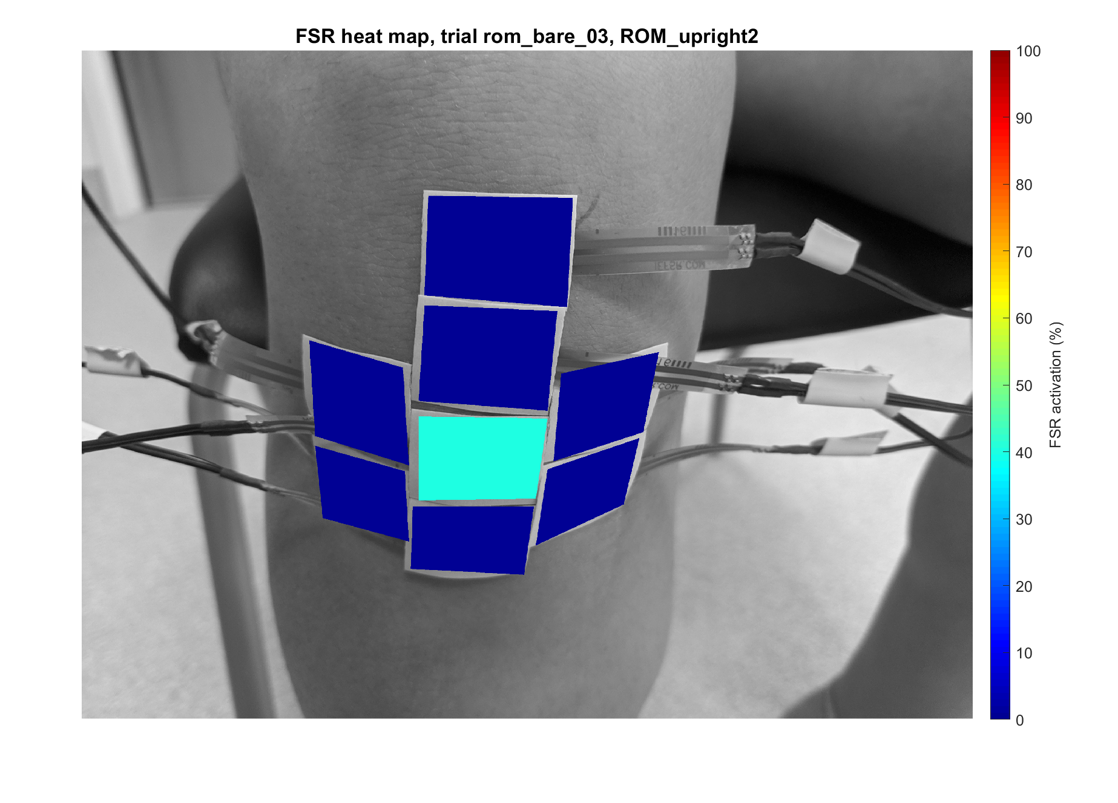
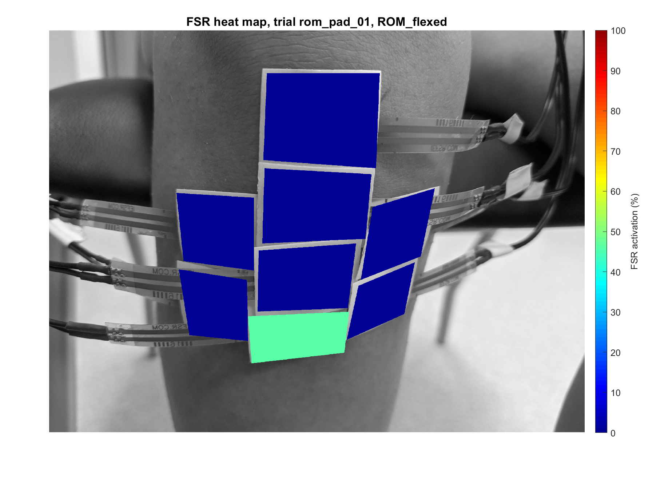
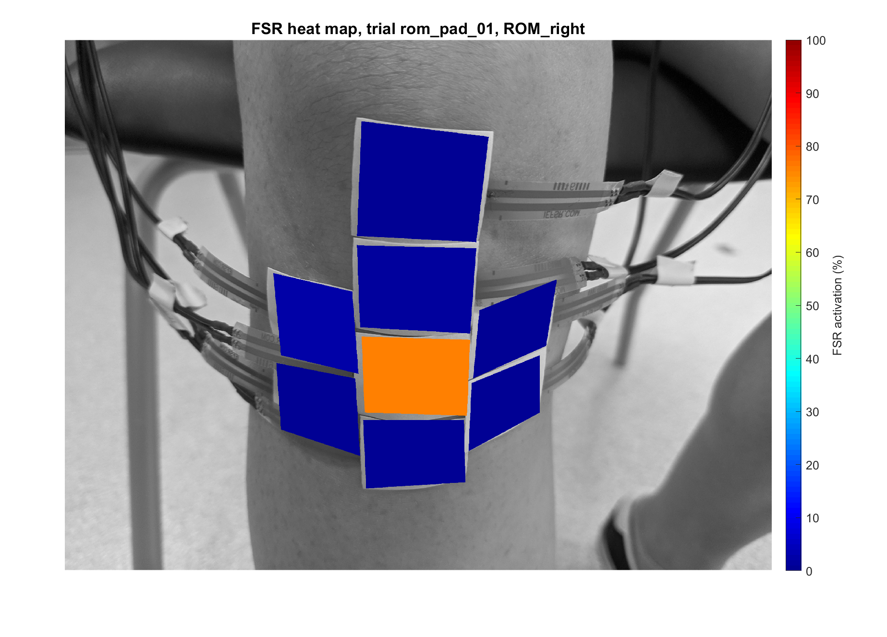
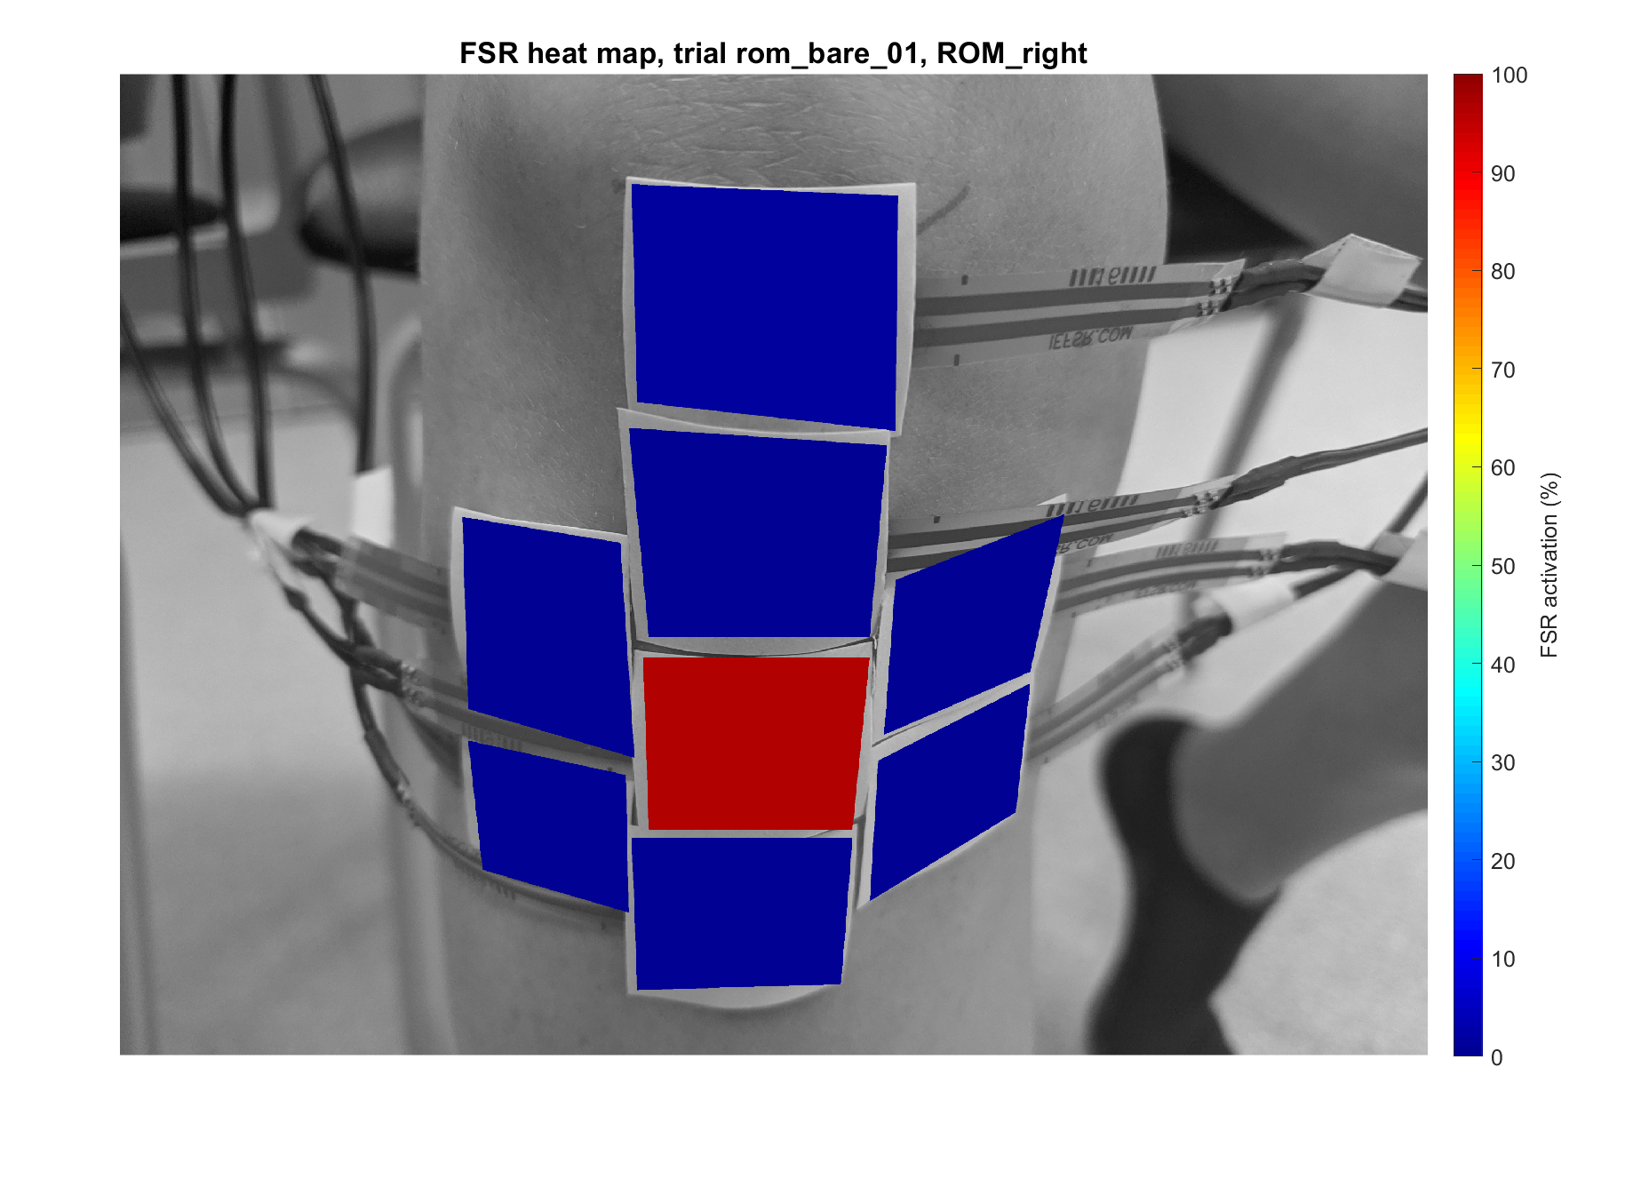

Slide 5
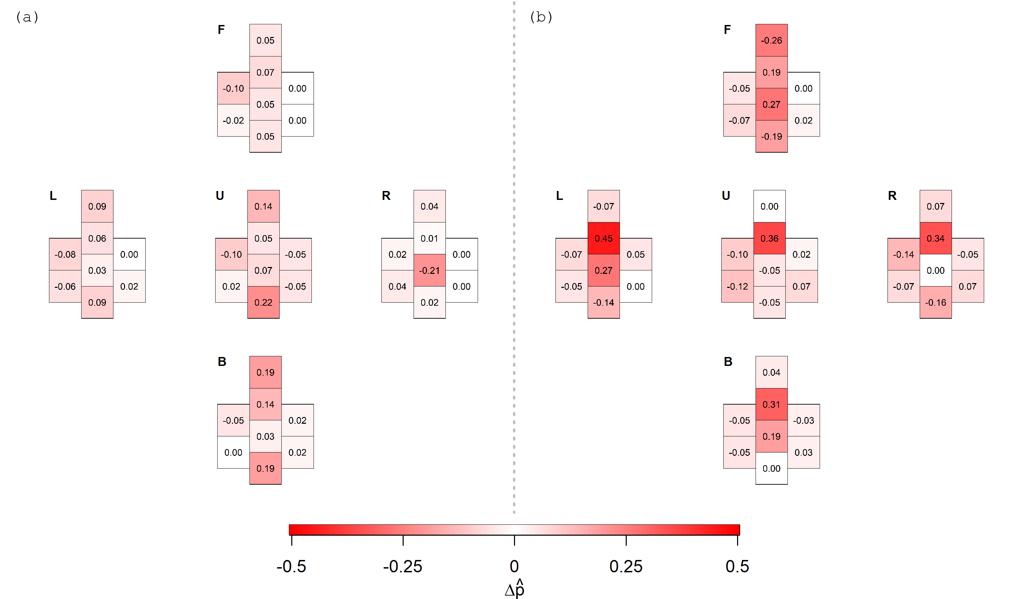
Change in proportion of FSR activation between sessions 1 and 2
Bare
Knee pads
Bare
No significant changes.
Knee pads
Significant changes at sensor b for upright kneeling, left and right reaching tasks.
Variability in knee pad placement likely cause for change in loading.
F – forward; L – left; U – upright; R – right; B – Back

Slide 6
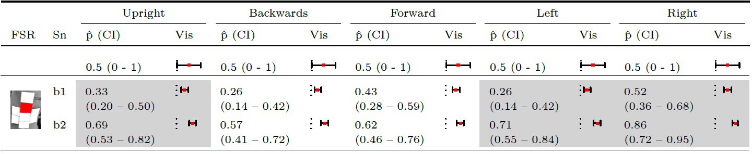

Knee pads
Sn – session; Vis – visualisation
All FSR Activation:
github.com/simon-thwaites/ABC12-2021_Kneeling_GitHub/tree/main/Supplementary-Material

Slide 7

Conclusion
Developed a technique for visualising the loading of the knee.
Knee pads reduced repeatability of the technique.
More here:
github.com/simon-thwaites/ABC12-2021_Kneeling_GitHub

